Slide 1
C1.3 – Algorithms and programs – part 4
Topic | Content
Introduction | The term algorithm and common methods of defining algorithms; pseudocode, flowcharts and structured English.
C1.3.1 Variables and constants | The use of constants and variables in algorithms and programs
C1.3.2 Identifiers | The importance of using of self-documenting identifiers, annotation and program layout in programs. Examples of self-documenting identifiers, annotation and appropriate program layout.
C1.3.3 Scope of variables | The scope and lifetime of variables in algorithms and programs
C1.3.4 Parameters | The purpose and effect of procedure calling, parameter passing and return, call by reference and call by value.

Slide 2
C1.3 – Algorithms and programs – part 4
Topic | Content
C1.3.5 Mathematical operations | Mathematical operations in algorithms, including DIV and MOD
C1.3.6 Sorting | the characteristics of sorting algorithms: bubble sort and insertion sort.
C1.3.7 Searching | Using linear search algorithm and binary search algorithm. Follow search and sort algorithms and programs; make alterations to such algorithms and write search algorithms and programs.
C1.3.8 Problem analysis | Analyse a problem using appropriate design approaches.
C1.3.9 Programming constructs | Use sequence, selection and repetition in algorithms and programs. Use counts and rogue values in algorithms and programs

Slide 3
C1.3 – Algorithms and programs – part 4
Topic | Content
C1.3.10 Modular programming | The use of standard functions, standard modules and user defined subprograms
C1.3.11 Logical operations in algorithms and programs | Logical operators AND, OR, NOT and XOR in algorithms and programs.
C1.3.12 Compression | Data compression and how data compression algorithms are used.
C1.3.13 Testing | Test data to dry-run a program or algorithm in order to identify possible errors. Show the effects of test data.

Slide 4
C1.3.6 Sorting C1.3.7 Searching

Slide 5
Bubble sort
Compare each element (except the last one) with its neighbour to the right
If they are out of order, swap them
This puts the largest element at the very end
The last element is now in the correct and final place
Compare each element (except the last two) with its neighbour to the right
If they are out of order, swap them
This puts the second largest element next to last
The last two elements are now in their correct and final places
Compare each element (except the last three) with its neighbour to the right
Continue as above until you have no unsorted elements on the left

Slide 6
Example of bubble sort
7
2
8
5
4
2
7
5
4
8
2
5
4
7
8
2
4
5
7
8
2
7
8
5
4
2
7
5
4
8
2
5
4
7
8
2
4
5
7
8
2
7
8
5
4
2
5
7
4
8
2
4
5
7
8
(done)
2
7
5
8
4
2
5
4
7
8
2
7
5
4
8

Slide 7
C# Code for bubble sort
public static void bubbleSort(int[] a) { int outer, inner; for (outer = a.length - 1; outer > 0; outer--) { // counting down for (inner = 0; inner < outer; inner++) { // bubbling up if (a[inner] > a[inner + 1]) { // if out of order... int temp = a[inner]; // ...then swap a[inner] = a[inner + 1]; a[inner + 1] = temp; } } } }

Slide 8
Analysis of insertion sort
We start with the second item and compare with the first
The second is placed in a temp position
If when we compare items they are greater than the temp then we shift up into vacated positions
Leaving an empty space for the item to be inserted into the correct place

Slide 9
One step of insertion sort
sorted
next to be inserted
3
4
7
12
14
14
20
21
33
38
10
55
9
23
28
16
temp
less than 10
10
3
4
7
10
12
14
14
20
21
33
38
55
9
23
28
16
sorted

Slide 10
Linear Search
Each record is checked in turn until the required record is found.
A linear search can be carried out on any file.

Slide 11
Looking for record with key 63…
75
29
40
18
63
Found it!

Slide 12
Binary Search
The data must be sorted.
Look at ‘middle’ record…and discard half the list.
Repeat the above step until record is found.

Slide 13
Looking for record with key 63…
39
63
68
75
Check the middle record
Check the middle record.
Check the middle record.

Slide 14
A Binary Search is much FASTER than a Linear Search…
…but only works if the list is SORTED.

Slide 15
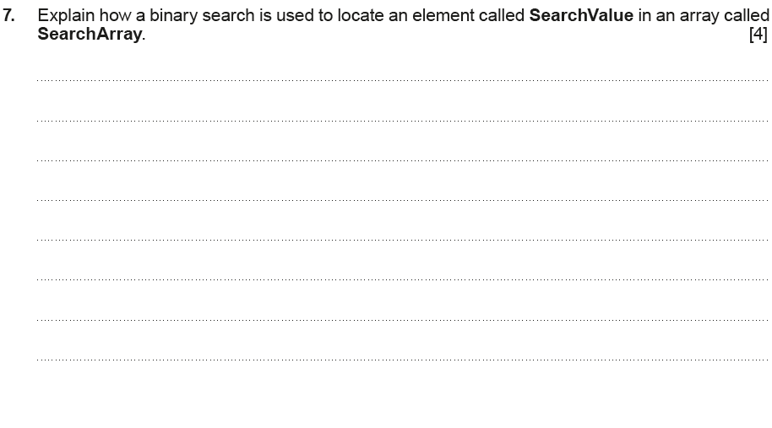
Example assessment …

Slide 16
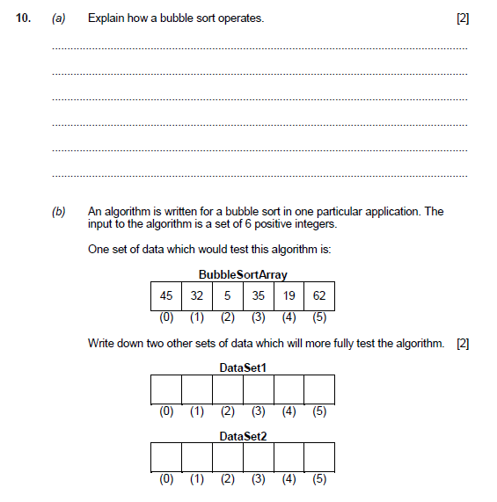
Example assessment …

